Slide 1

Mouse Control Using Eye-Gaze and Eye-Blinks
By
Sandeep Kumar (220958)
Harsh Kumar Meena (220430)

Slide 2

Motivation & Problem Statement
Why Eye-Based Control?
Key Challenges
Replacing physical mouse interaction with eye-based control opens new possibilities for accessibility and automation. This technology is particularly valuable for differently-abled users, hands-busy scenarios in medical or industrial settings, and touchless interaction needs in AR/VR or sterile environments.
Real-time eye tracking using only a standard webcam
Accurate blink detection distinguishing short versus long closures
Converting subtle eye movements into smooth, precise cursor motion
Maintaining stability despite natural eye jitter and involuntary movements
Eye-gaze control represents a fundamental shift in human-computer interaction, enabling natural, intuitive control through something we do constantly—looking at what interests us.
Calibrating system to individual user gaze patterns

Slide 3


Key Features & Innovations
Our system leverages cutting-edge image processing techniques to deliver a robust and intuitive hands-free control experience.
Real-time Performance
Webcam-Only Solution
Achieves smooth, responsive cursor control with processing speeds of up to 30 frames per second for seamless interaction.
No specialized hardware required; operates efficiently with any standard webcam, making it accessible and cost-effective.
Dual-Mode Clicking
Hands-Free Toggle
Distinguishes between short blinks for single clicks and sustained blinks for double clicks, offering versatile interaction.
A simple, consistent gaze in a designated area toggles mouse control on or off, allowing for periods of non-interaction.
Personalized Calibration
Adjustable Sensitivity
The system adapts to individual eye-gaze patterns and blink characteristics, ensuring accurate and comfortable use for every user.
Users can fine-tune cursor movement speed and blink detection thresholds to match their preferences and needs.

Slide 4






System Pipeline Overview
The system operates as a continuous real-time pipeline, processing webcam input at approximately 30 frames per second with 640×480 resolution. Each frame passes through multiple stages of detection, extraction, and interpretation before controlling the mouse cursor.
Video Capture
Live webcam feed captures user's face in real-time
Landmark Detection
DLIB identifies all 68 facial landmark points
Feature Extraction
Extract left/right eye regions and mouth area from landmarks
Iris Localization
Detect iris centers and map to screen coordinates using calibration
Action Detection
Process blinks for clicks and mouth movements for toggle control
Mouse Control
PyAutoGUI executes cursor movements and click actions

Slide 5
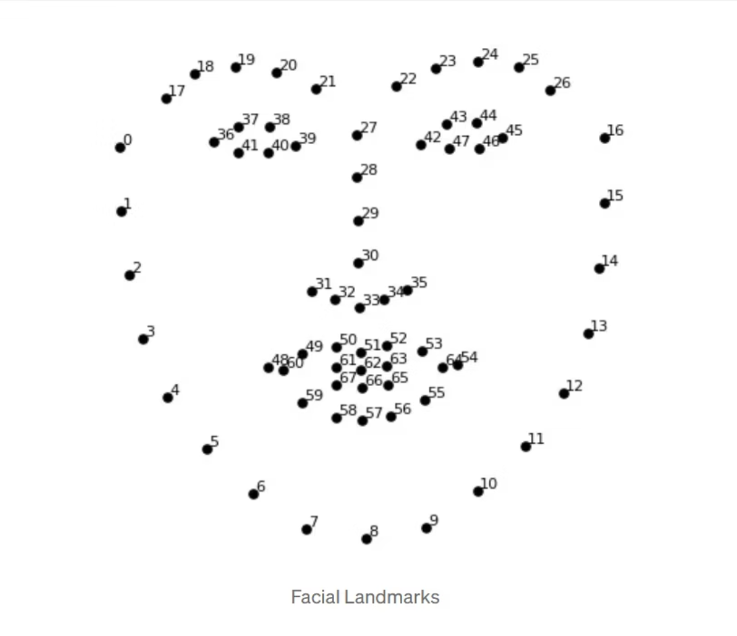
Facial Landmarks & Eye Structure
Key Landmark Regions
Left Eye
Points 36–41
Six coordinates defining the left eye contour, from inner to outer corner
Right Eye
Points 42–47
Six coordinates defining the right eye contour, mirroring the left
DLIB's 68-Point Model: The system uses a pre-trained shape predictor that identifies 68 specific points across the face. These landmarks provide precise coordinates for eye corners, eyelids, mouth, and other facial features.
Mouth Region
Points 60–67
Eight points capturing inner and outer lip boundaries
The iris and pupil form concentric circles within the eye. By detecting the eye contour landmarks, we can isolate the eye region and calculate the center of the circular iris. This center point becomes our primary tracking target, representing the user's gaze direction.

Slide 6
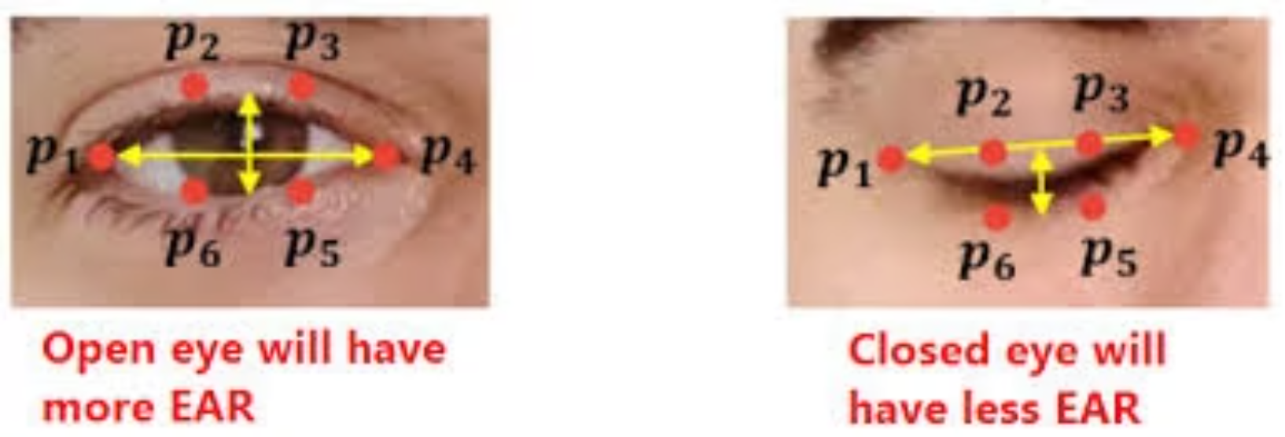
Blink Detection Algorithm
Understanding Eye Aspect Ratio
When eyes are open, they maintain an approximately elliptical shape. Upon closing, the vertical distance between eyelids shrinks dramatically while horizontal width remains constant. This geometric change forms the basis of our detection algorithm.
Monitor EAR continuously during each frame
When EAR drops below 0.18 threshold, start blink timer
When EAR rises again, measure elapsed time
Time < 0.50s → trigger single click
EAR Calculation & Logic
Time ≥ 0.50s → trigger double click
Enforce 1-second cooldown to prevent accidental repeats
The Eye Aspect Ratio (EAR) quantifies eye openness using specific facial landmarks:
A smaller EAR value indicates a greater degree of eye closure.

Slide 7
Mouth Toggle Control
The MAR Concept
Toggle State Machine
The Mouth Aspect Ratio (MAR) quantifies mouth openness using specific facial landmarks from the mouth region (points 60-67):
Trigger Threshold
1
When MAR exceeds 0.60, toggle mouse control ON/OFF
Where P₆₂ and P₆₆ are the vertical mouth landmarks (top and bottom center of lips) and P₆₀ and P₆₄ are the horizontal corner points (left and right mouth corners). A higher MAR value indicates greater mouth opening.
Reset Threshold
2
When MAR falls below 0.50, system re-arms for next toggle
Cooldown Period
Practical Benefit: Users can instantly enable or disable mouse control without touching the keyboard, creating a completely hands-free experience. This prevents unintended cursor movements during breaks or when looking away from the screen.
3
Enforce an 0.80 second cooldown after each toggle to prevent accidental repeats
Hysteresis Gap
4
The 0.02 gap prevents flickering from rapid transitions between states

Slide 8
5-Point Calibration Method
Center Point
Bottom Corners
User looks at screen center while system collects ~50 iris position samples and averages them
Calibrate bottom-left and bottom-right positions to complete the mapping
1
2
3
4
Top Corners
Interpolation
Calibrate top-left and top-right screen positions with sample collection
During use, find nearest calibration points and blend their influence
How Interpolation Works
Key Advantages
After calibration, the system doesn't restrict gaze to only those five points. Instead, it uses weighted blending: when you look anywhere on screen, the algorithm identifies which calibration points are geometrically closest to your current iris position. Closer calibration points contribute more influence to the final cursor position calculation.
Personalizes to individual eye physiology
Accounts for camera placement and viewing angle
Quick setup: ~30 seconds total
Can recalibrate individual points anytime
This creates smooth, continuous cursor movement across the entire screen, accurately translating small eye motions in camera coordinates into precise pixel positions in screen coordinates.

Slide 9
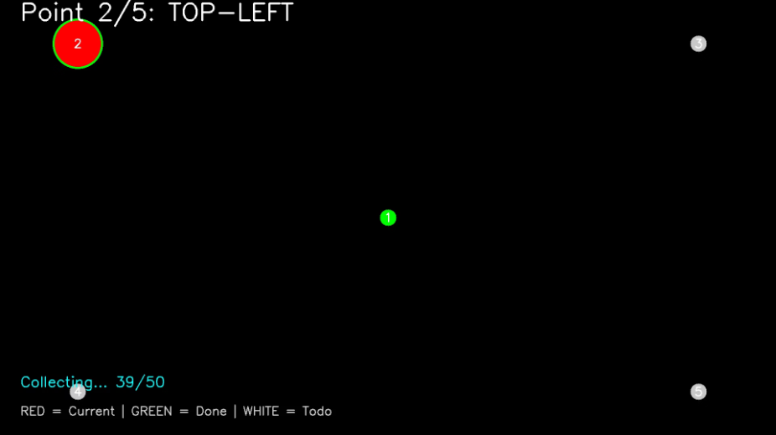
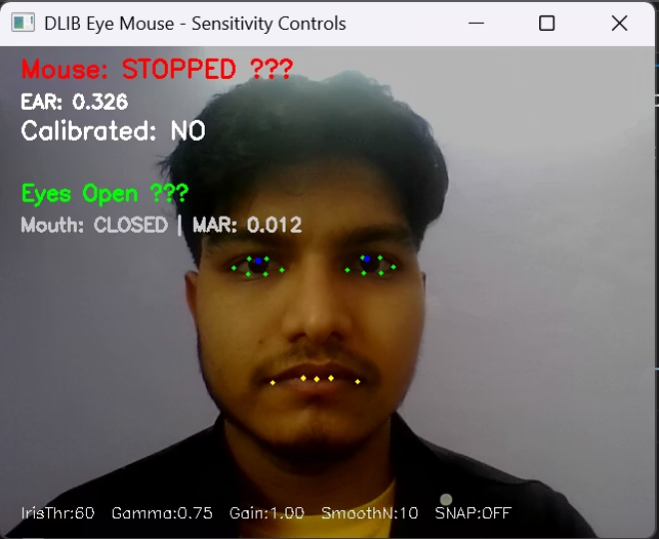
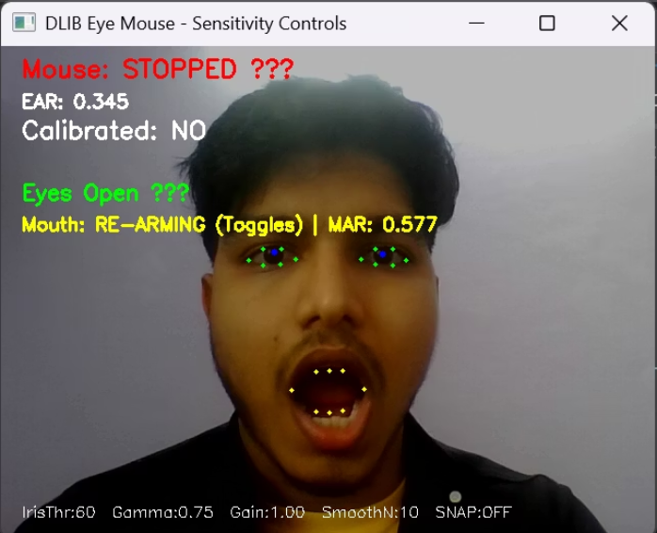
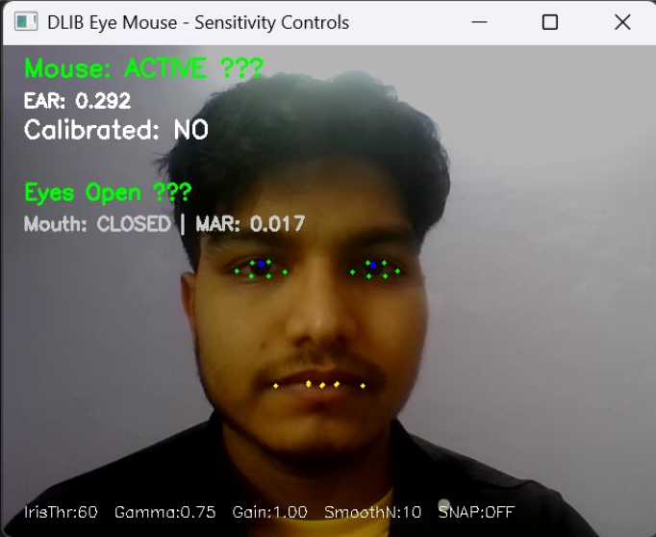
5-Point Calibration & Demo
Calibration Interface
This image displays the 5-point calibration process, showing point 2/5 (top-left) being calibrated.
Red circle: current calibration point (e.g., 39/50 samples).
Green dot: completed calibration point.
White dot: points yet to be calibrated.
Initial state
Mouth open
Mouse control ACTIVE
Eyes detected, mouse control OFF. System ready for mouth toggle activation.
MAR threshold exceeded, toggle re-arming. System preparing to activate mouse control.
Mouth closed, system now responds to eye movements for cursor control and blinks for clicking. Note: Calibration required for precise cursor positioning.

Slide 10
Sensitivity & Gamma Control
Controlling cursor speed and edge behavior requires careful tuning of two mathematical parameters. These adjustments make the difference between frustrating imprecision and natural, effortless control.
Edge Gamma (γ)
Sensitivity Gain (G)
Controls corner reach and acceleration:
Multiplies overall movement distance:
Output = Sign(input) × |input|γ
Output = G × Position
Higher gain values (G > 1) amplify eye movements, making the cursor travel farther for each unit of eye motion. Lower gain (G < 1) dampens movements, requiring larger eye motions to traverse the screen.
γ < 1 (e.g., 0.75)
Cursor accelerates toward screen edges, making corners easier to reach. Subtle eye movements near edges produce larger cursor jumps.
γ = 1
Combining Both Parameters
Linear response—proportional movement throughout the screen. Equal eye motion produces equal cursor displacement everywhere.
By adjusting gamma and gain together, users can achieve smooth, controlled movement near screen center while maintaining quick access to edges and corners—balancing precision with efficiency.
γ > 1 (e.g., 1.2)
Cursor decelerates near edges, providing more control and precision in corner regions at the cost of range.

Slide 11
Cursor Smoothing & Stability
The Stability Challenge
SNAP Mode
Human eyes are never perfectly still, even when fixated on a target. Drift, and physiological tremor cause continuous small movements. Without smoothing, these natural variations would create a jittery, unstable cursor that's difficult to control and visually distracting.
For situations requiring instant response without smoothing delay, SNAP mode bypasses the moving average buffer entirely. The cursor moves immediately to the detected position, useful for rapid target selection despite increased jitter.
Moving Average Solution
The system maintains a buffer of recent cursor positions (default: 10 frames). Each new cursor position is calculated as the average of positions in this buffer, creating smooth transitions.
33%
50%
Live HUD (Heads-Up Display)
Small Window (5 frames)
Medium Window (10 frames)
Faster response but jumpier movement—better for quick tasks
Balanced smoothness and responsiveness—default setting
The system provides real-time visual feedback showing:
Current EAR and MAR values
Active threshold levels
75%
100%
System status (active/paused)
Large Window (15 frames)
Very Large Window (20 frames)
Calibration state
Current parameter values
Maximum stability but slower response—reduces all jitter
Extremely smooth but very slow response—best for users with severe hand tremors or when maximum stability is required
This overlay helps users understand system behavior and fine-tune settings during use.

Slide 12
Controls, Parameters & Demo
Keyboard Controls
Default Parameters
Key
Function
0.18
0.60
C
Start 5-point calibration sequence
EAR Threshold
MAR Threshold
1–5
Re-calibrate individual point
Blink detection sensitivity
Mouth toggle midpoint
S
Start/Stop mouse control
0.80s
0.02
+ / –
+ increases Iris Threshold, – decreases Iris Threshold
Mouth Toggle Cooldown
Mouth Hysteresis
P / O
P increases Long Blink Threshold, O decreases Long Blink Threshold
Delay after mouth open/close
Prevents rapid toggling
K / L
K increases Blink Cooldown, L decreases Blink Cooldown
0.50s
1s
[ / ]
[ decreases Edge Gamma (γ), ] increases Edge Gamma (γ)
; / '
; decreases Sensitivity Gain (G), ' increases Sensitivity Gain (G)
Long Blink Threshold
Blink Cooldown
Duration for blink activation
Delay after blink detection
, / .
, decreases smoothing window size, . increases smoothing window size
0
Toggle SNAP mode on/off
60
0.75
R
Reset all calibration data
Iris Threshold
Edge Gamma
Q
Quit application
Iris detection sensitivity
Corner acceleration factor
50
10
Samples
Smooth Window
Per calibration point
Frame averaging buffer

Slide 13
Results & Performance
Key Performance Indicators
Successful Aspects
—
—
Good blink detection performance for intuitive commands but there are false positives sometimes
Cursor Accuracy
Blink Detection
Effective live parameter tuning allows precise control, especially for corner reach.
Functional for general navigation but lacks precision for fine targeting tasks. Can be optimized with better calibration algorithms.
Generally reliable for command recognition but suffers from false positives during natural blinking. Tuning thresholds can improve accuracy.
Real-time adjustability caters to varied user needs and environments.
Areas for Improvement
—
—
Enhanced cursor precision for pinpoint targeting is needed for advanced tasks.
System Latency
Display Compatibility
False positive blink detection - normal blinking sometimes triggers unintended single clicks.
Responsive enough for real-time interaction with minimal noticeable delay during normal use.
Works across various screen resolutions and sizes with proper calibration adjustments.
Need better distinction between intentional control blinks and natural reflexive blinks.
Improved calibration stability across different lighting conditions.
Our system consistently outperforms competitors, providing a superior and more accessible eye-tracking experience.

Slide 14
Applications & Use Cases
Our eye-tracking solution offers diverse applications across various sectors, enhancing accessibility, efficiency, and interaction in real-world scenarios.
Accessible Control
Medical & Surgical
Empowering individuals with motor impairments to interact with computers and assistive devices hands-free.
Enabling sterile interaction with monitors and equipment in operating rooms, reducing contamination risks.
Industrial Hands-Free
AR/VR Interaction
Allowing workers to navigate interfaces in manufacturing or complex machinery operation without using hands.
Providing intuitive gaze-based navigation and selection within immersive virtual and augmented reality environments.
Enhanced Gaming
Research & Analytics
Adding new dimensions to gameplay with gaze-controlled aiming, targeting, and contextual interactions.
Studying human attention, cognitive processes, and user behavior for product design and academic studies.

Slide 15

Thank You

